Slide 1
www.unipd.it/en

Slide 2
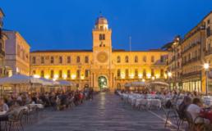
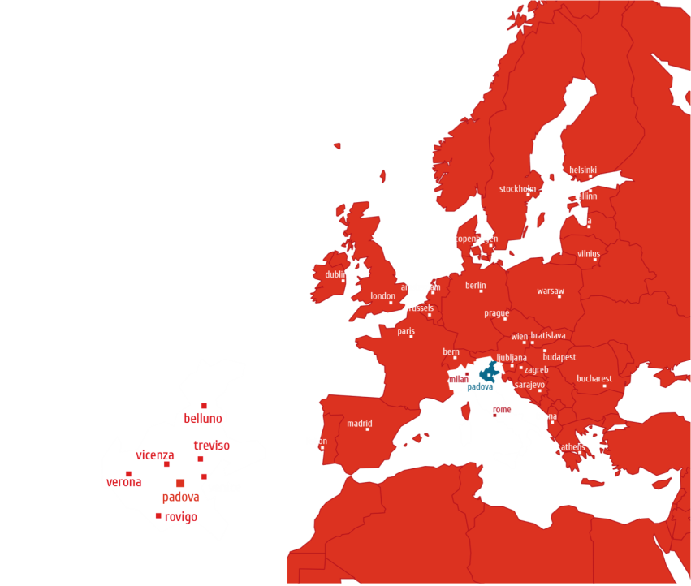
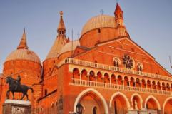
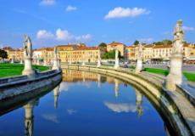
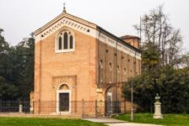
Padova, Italy
Venice, Italy:

Slide 3
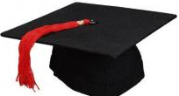
Since 2012
8 SCHOOLS coordinate Academic Education
Agricultural Sciences and Veterinary Medicine
School of Economics and Political Sciences
Law
Engineering
Medicine (including Pharmacy related courses)
Psychology
Sciences
Human and Social Sciences and Cultural Heritage

Slide 4
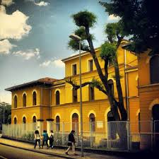
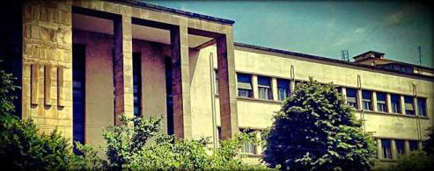
Department of Pharmaceutical and Pharmacological Sciences
… in the School of Medicine
The Department of Pharmaceutical and Pharmacological Sciences (DPPS) manages education in the disciplines related to Pharmacy and Pharmacology
DPPS staff counts 53 lecturers/professors, over 14 technicians, 15 administratives, 4 general services and about 100 young researchers under training, including PhD students and post-doctoral fellows.

Slide 5
Department of Pharmaceutical and Pharmacological Sciences
Notes:
5

Slide 6
Department of Pharmaceutical and Pharmacological Sciences
Governance
Director and Vice-Director
Departmental Council
Resource and development Committee
Scientific Committee
Internationalization Committee
Educational Committee
Service and Logistics Committee
Notes:
6

Slide 7
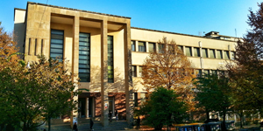
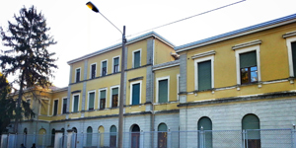
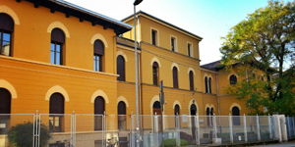
Department of Pharmaceutical and Pharmacological Sciences
DPPS Building A
(Via Marzolo n.5)
6 Teaching classrooms
5 Teaching laboratories
Lecturer offices
Research laboratories
Student study rooms
Library
DPPS Building B
(Via Loredan n.16)
1 big Teaching classroom
Lecturer offices
Research laboratories
Small meeting rooms
IT room
DPPS Building C – Pharmacology
(Largo Meneghetti n.2)
3 Teaching classrooms
Lecturer offices
Research laboratories
IT room
Library
Notes:
7

Slide 8
http://www.dsfarm.unipd.it/

Slide 9
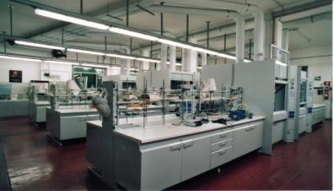
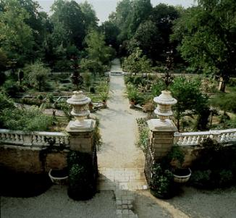
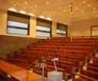
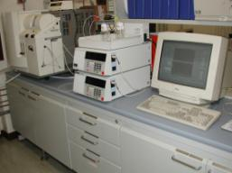
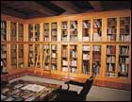
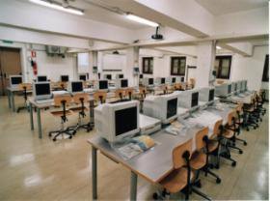
Department of Pharmaceutical and Pharmacological Sciences
Educational Laboratories
Ancient (1545)
Botanical Garden
Class room
IT room
Research laboratory
Library
Notes:
9

Slide 10
Department of Pharmaceutical and Pharmacological Sciences
Bachelor (3 years) in:
Applied Pharmaceutical Science
Master (5 years) in:
Pharmacy
Pharmaceutical Chemistry and Technology
Master (2 years, post 3 year-Bachelor in Biotechnologies) in:
Pharmaceutical Biotechnologies: HELD IN ENGLISH
Specialization School in Hospital Pharmacy (4 years including residency)
Post graduate courses (1 year)
Business and Management: Perfume and Fragrances Industries and Cosmetics Sector
Clinical Pharmacy and Pharmacology
Medical devices
Pharmaceutical Logistics
Radiopharmacy

Slide 11
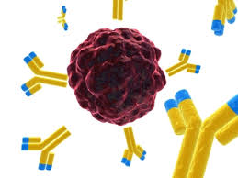
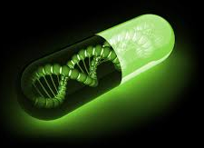
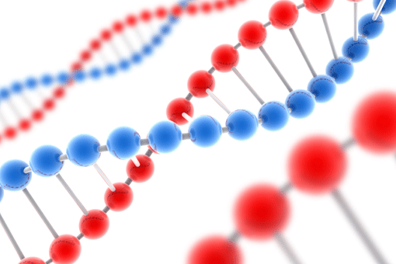
Department of Pharmaceutical and Pharmacological Sciences
Master of Science (2 years) in ENGLISH:
Pharmaceutical Biotechnologies
The students enrolled in Pharmaceutical Biotechnologies will acquire a solid knowledge in biochemistry, molecular biology and protein engineering, immunology, pharmacology and pharmaceutical technology, and in those disciplines required to design, analyze and formulate innovative drugs such as biologics and drugs employed in targeted therapies.
Notes:
11

Slide 12
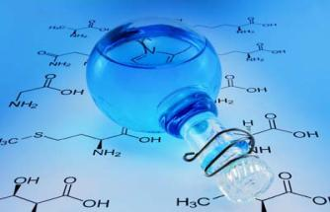
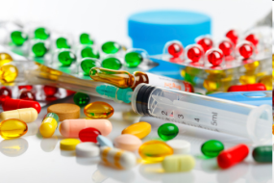
Department of Pharmaceutical and Pharmacological Sciences
Integrated Master level course (5-years)
Pharmacy (in Italian)
The MPharm provides education on
the scientific basis of medicines,
from the chemical structure and the molecular mechanism of action
to the pharmaceutical preparation and clinical use of therapeutics
Notes:
12

Slide 13
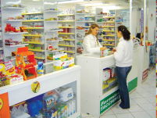
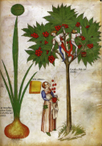
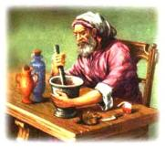
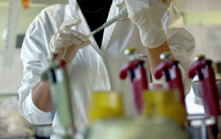
Department of Pharmaceutical and Pharmacological Sciences
Integrated Master level curriculum (5-years)
Pharmacy
The attendance to theoretical courses and laboratory experiences as well as internship at Local Health Hospital/Districts and Community Pharmacies provides the specific knowledge and skills to the students for their professional career
mainly as Community-based pharmacists or Pharmaceutical sales representative

Slide 14
MS in Pharmacy
Department of Pharmaceutical and Pharmacological Sciences
Courses related to the Pharmacy Profession
Pharmacy Internship Program (2 options)
in Community Pharmacy → 6 months
in Community Pharmacy + in Hospital Pharmacy → 3 months + 3 months
Final Thesis (2 options)
Literature Review → 3 months (minimum)
Supervised Experimental Research → 7 months (minimum)

Slide 15
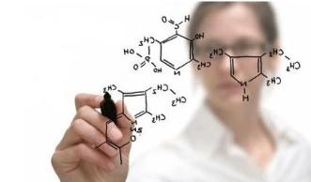
Department of Pharmaceutical and Pharmacological Sciences
Integrated Master of
Pharmaceutical Chemistry and Technology
(5-years)
This course has been designed to include multiple disciplines combining elements of chemistry, pharmacy, molecular and clinical pharmacology and regulatory issues. Students develop laboratory expertise, learn to design, develop and test innovative medicines, and understand the clinical trial and regulatory pathways that bring new drugs from initial idea through to the patient.

Slide 16
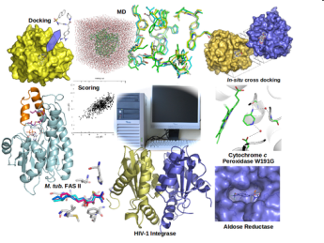
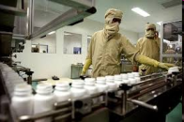
Pharmaceutical Chemistry and Technology
Department of Pharmaceutical and Pharmacological Sciences
Students acquire skills in analytical chemistry, biotechnology, nanotechnology, molecular pharmacology and toxicology useful for a career in bio-pharmaceutical industry, but also in Pharmacy.

Slide 17
MS in Pharmaceutical Chemistry and Technology
Department of Pharmaceutical and Pharmacological Sciences
Three different curricula
3 courses per each curriculum
Biotech
Drug Science and Development
Industrial
Pharmacy Internship Program (2 options)
in Community Pharmacy → 6 months
in Community Pharmacy + in Hospital Pharmacy → 3 months + 3 months
Final Thesis
Supervised Experimental Research → 7 months (minimum)

Slide 18
Department of Pharmaceutical and Pharmacological Sciences
Bachelor (3 years) in:
Applied Pharmaceutical Science
This Course provides to the students the know-how and ability to carry out technical and management tasks and professional activities in the areas of
transformation of medicinal herbs,
management of the quality of the processes,
marketing of medicinal plants and derivatives for use in herbal, food and cosmetic products, guaranteeing conformity with the national and EU laws in force.
Notes:
18

Slide 19
Department of Pharmaceutical and Pharmacological Sciences
PhD Schools
Pharmacological Sciences
Molecular Medicine: Regenerative Medicines
(in collaboration with the Department of Molecular Medicine)
Molecular Sciences: Pharmaceutical Sciences
(in collaboration with the Department of Chemical Sciences)
Notes:
19

Slide 20
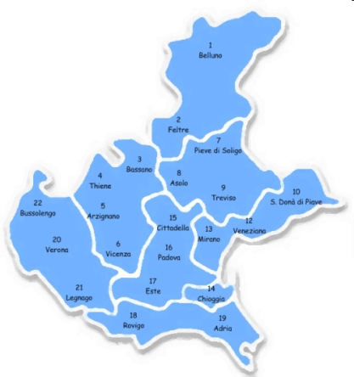
Department of Pharmaceutical and Pharmacological Sciences
Professionalizing Internship in Pharmacy
Partners
Veneto Region:
20 Local Health Districts

Slide 21
University Padova Hospital Veneto Oncology Institute – IOV Local Healthcare ULSS 16 Padova Hospitals (2)
Department of Pharmaceutical and Pharmacological Sciences
485.991 residents
5 Hospitals + 4 Hospital Pharmacies (1500-2000 beds)
3.130 beds in Disable Aged Care Facilities (RSA)
> 10.000 beds in AD (home health care)
329 General practitioners
55 Pediatricians in community
118 Community Pharmacies
1 Pharmaceutical Service
2 Ethics Committee for Clinical Trial
1 Ethics Committee for research in Community setting (CoRiTer)
Notes:
21

Slide 22
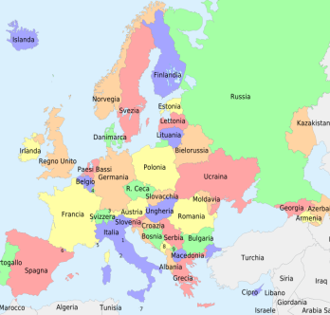
Department of Pharmaceutical and Pharmacological Sciences
International Activities: Mobility programs
Many students attending the Courses related to Pharmacy discipline have been involved within the framework of the Erasmus+ Programme, Erasmus Mundus and other international programs
Erasmus bilateral agreements have been signed with several European Countries
Marco Polo students: http://www.unipd.it/en/marco-polo-project

Slide 23
Department of Pharmaceutical and Pharmacological Sciences
International Activities: Teaching
Teaching staff exchanges
Visiting Professors
BINDER: multilateral agreement

Slide 24
Department of Pharmaceutical and Pharmacological Sciences
Contacts
Director
Prof. Paolo Caliceti email: paolo.caliceti@unipd.it
International Relations Advisor
Prof. Barbara Gatto email: barbara.gatto@unipd.it
Scientific Committee Advisor
Prof. Vincenzo De Filippis email: vincenzo.defilippis@unipd.it
Technology Transfer Advisor
Prof. Nicola Ferri email: nicola.ferri@unipd.it
Scientific Officer
Dott. Maddalena Murari email: maddalena.murari@unipd.it
Student Office
Dott. Claudia Veronese email: claudia.veronese@unipd.it

